Slide 1
DDOS

Slide 2
What is DoS
A denial of service (DoS) is an action that prevents or impairs the authorized use of networks, systems, or applications by exhausting resources such as central processing units (CPU), memory, bandwidth, and disk space.

Slide 3
What is DoS
Several categories of resources that could be attacked:
Network bandwidth
System resources
Application resources

Slide 4
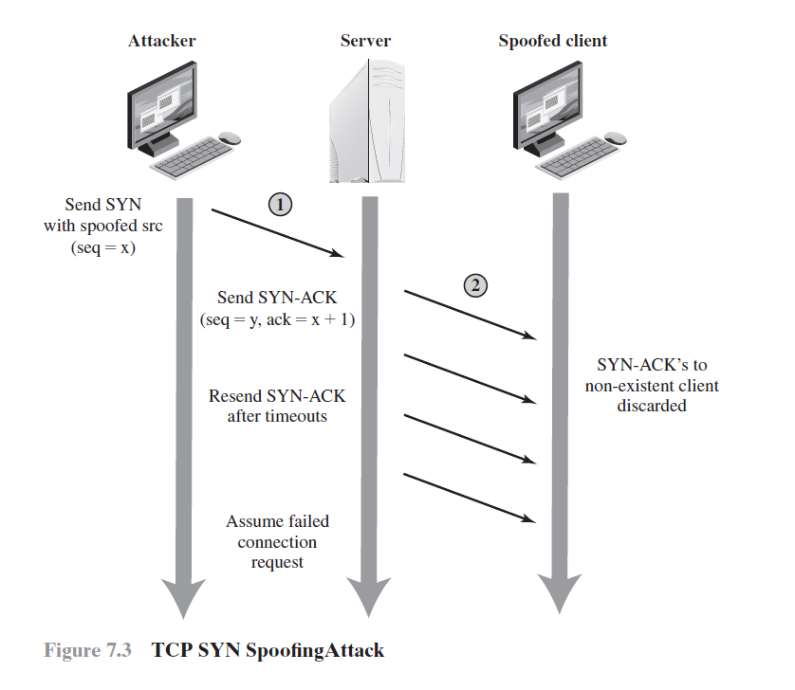
Example
Classic Denial-of-Service Attacks
Source Address Spoofing
Syn Spoofing

Slide 5
Flooding Attacks.
Distributed denial-of-Service Attacks.
Application-based bandwidth Attacks.
Reflector and amplifier Attacks.

Slide 6
Flooding Attacks.
Take a variety of forms, based on which network protocol is being used to implement the attack. In all cases the intent is generally to overload the network capacity on some link to a server.
ICMP Flood
UDP Flood
TCP SYN Flood

Slide 7
SYN-flooding Attack
Very common denial-of-service attack, aka Neptune
Attacker starts handshake with SYN-marked segment
Victim replies with SYN-ACK segment
Attacker… stays silent
Note that the source IP of the attacker can be spoofed, since no final ACK is required
A host can keep a limited number of TCP connections in half-open state. After that limit, it cannot accept any more connections

Slide 8
SYN-flooding Attack
Current solutions
Filtering
Increase the length of the half-open connection queue
Reduce the SYN-received timeout
Drop half-open connections when the limit has been reached and new requests for connection arrive
Limit the number of half-open connections from a specific source
Use SYN cookies
See TCP SYN Flooding Attacks and Common Mitigations, RFC 4987

Slide 9
SYN Cookies
Special algorithm used for determining the initial sequence number of the server
The number is
Top 5 bits: t mod 32, where t is a 32-bit time counter that increases every 64 seconds
Following 3 bits: the encoding of the Maximum Segment Size (MSS) chosen by the server in response to the client's MSS
A keyed hash of:
Counter t
Source/Destination IP addresses and ports

Slide 10
SYN Cookies
A server that uses SYN cookies sends back a SYN+ACK, exactly as if the SYN queue had been larger
When the server receives an ACK, it checks that the secret function works for a recent value of t, and then rebuilds the SYN queue entry (using the encoded MSS info)
Drawbacks:
The server sequence number grows faster than normal
The MSS value is limited by the encoding procedure (only 8 possible values)
No data can be included in the initial SYN

Slide 11
Distributed denial-of-Service Attacks
The limitations of flooding attacks generated by a single system.
We can improve this limitations by using multiple system to generate attacks
These systems were typically compromised user workstations or PCs
The attacker uses malware to subvert the system and install an attack agent which they can control
Such systems are known as zombies

Slide 12
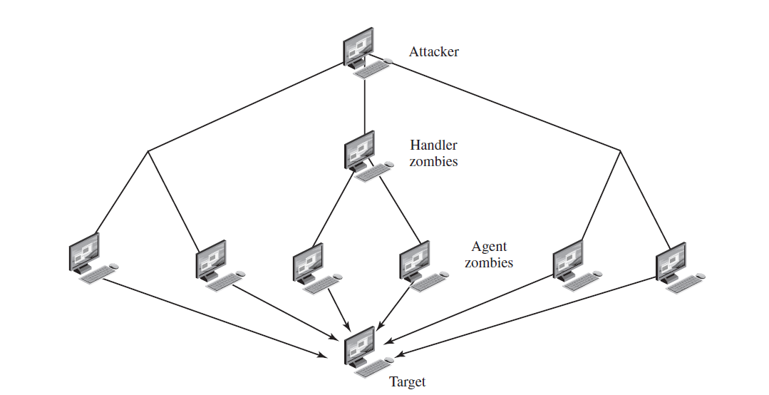
Distributed denial-of-Service Attacks

Slide 13
Application-based bandwidth Attacks
A potentially effective strategy for denial of service is to force the target to execute resource-consuming operations that are disproportionate to the attack effort.
SIP Flood
HTTP Based Attack

Slide 14
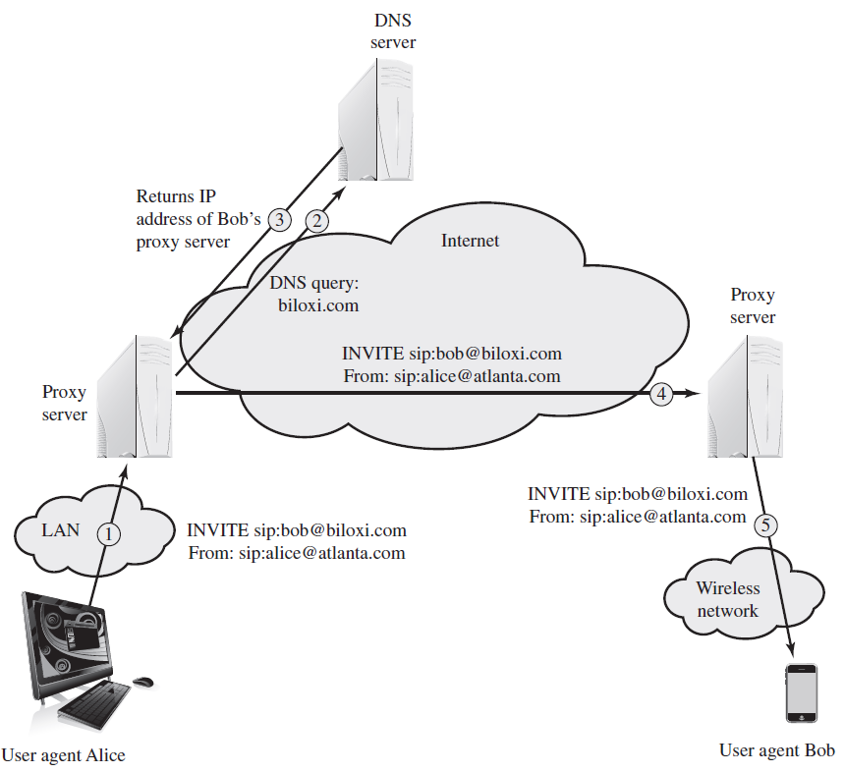
SIP Flood

Slide 15
HTTP Based Attack
HTTP Flood
An HTTP flood refers to an attack that bombards Web servers with HTTP requests.
Typically, this is a DDoS attack, with HTTP requests coming from many different bots.
Slowloris
Exploits the common server technique of using multiple threads to support multiple requests to the same server application
Exhaust all of the available request handling threads on the Web server by sending HTTP requests that never complete.

Slide 16
Reflector and amplifier Attacks
Reflector and amplifier attacks use network systems functioning normally.
The attacker sends a network packet with a spoofed source address to a service running on some network server.
The server responds to this packet, sending it to the spoofed source address that belongs to the actual attack

Slide 17
Reflection Attacks
Ideally the attacker would like to use a service that created a larger response packet than the original request.
This allows the attacker to convert a lower volume stream of packets from the originating system into a higher volume of packet data from the intermediary directed at the target
UDP, ICMP, DNS, SNMP …

Slide 18
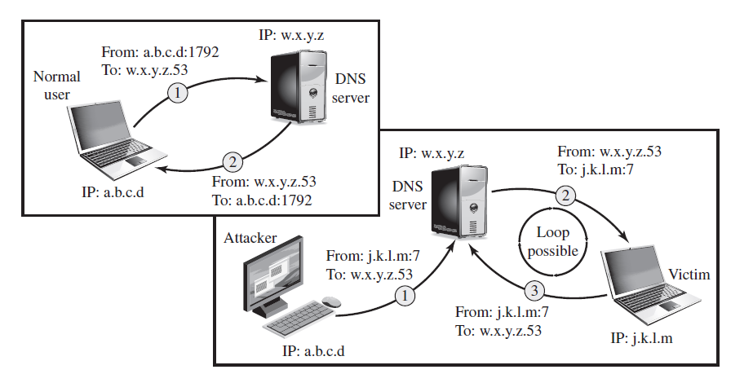
Reflection Attacks

Slide 19
Amplification Attacks
are a variant of reflector attacks and also involve sending a packet with a spoofed source address for the target system to intermediaries.
They differ in generating multiple response packets for each original packet sent.

Slide 20
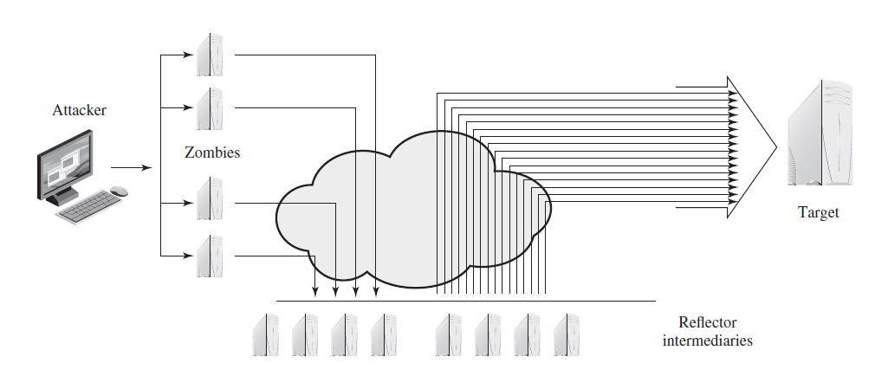
Amplification Attacks

Slide 21
Defenses against denial-of-service Attacks
It is important to recognize that these attacks cannot be prevented entirely.
In general, there are four lines of defense against DDoS attacks
Attack prevention and preemption (before the attack)
Attack detection and filtering (during the attack)
Attack source traceback and identification (during and after the attack)
Attack reaction (after the attack)
Notes:
Attack prevention and preemption (before the attack): These mechanisms
enable the victim to endure attack attempts without denying service to legitimate
clients. Techniques include enforcing policies for resource consumption
and providing backup resources available on demand. In addition, prevention
mechanisms modify systems and protocols on the Internet to reduce the
Possibility of DDoS attacks.
• Attack detection and filtering (during the attack): These mechanisms attempt
to detect the attack as it begins and respond immediately. This minimizes the
impact of the attack on the target. Detection involves looking for suspicious
patterns of behavior. Response involves filtering out packets likely to be part
of the attack.
• Attack source traceback and identification (during and after the attack): This
is an attempt to identify the source of the attack as a first step in preventing
future attacks. However, this method typically does not yield results fast
enough, if at all, to mitigate an ongoing attack.
• Attack reaction (after the attack): This is an attempt to eliminate or curtail the
effects of an attack.

Slide 22
Attack prevention and preemption (before the attack)
Prevent your systems from being compromised.
Filters are in place that block spoofed-source packets.
Block the use of IP-directed broadcasts
Mirroring and replicating these servers over multiple sites with multiple network connections.

Slide 23
Attack detection and filtering (during the attack)
Syn Cookies.
Drop an entry for an incomplete connection from the TCP connections table when it overflows.
Identify legitimate, generally human initiated, interactions from automated DoS attacks. These often take the form of a graphical puzzle, a captcha.

Slide 24
Q/A
Reading chapter 7 in Text book

